Slide 1
Introduction to Machine Learning
Prof.N.L.Bhanu Murthy

Slide 2
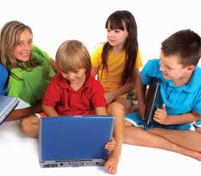
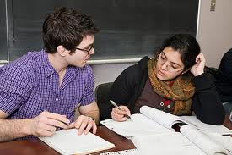

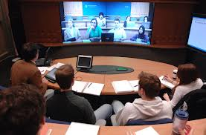
What is Learning?
“Gain knowledge or understanding of or skill in by study, instruction or experience”
- Webster

Slide 3
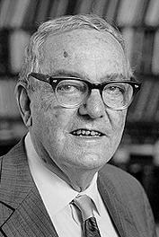
What is Learning?
“Learning is any process by which a system improves performance from experience.”
- Herbert Simon
Researcher in
Artificial Intelligence
Cognitive psychology
Computer science
Economics
Political science
Professor @
Carnegie Mellon University
University of California, Berkeley
Illinois Institute of Technology
Awards:
Turing Award, 1975
Nobel Prize in Economics1978
National Medal of Science1986
von Neumann Theory Prize1988
1916 - 2001

Slide 4

What is Machine Learning?
Machine Learning is study of algorithms that
improve their performance P
at some task T
with experience E
Tom Mitchell (1990)
Well-defined learning task: <P,T,E>

Slide 5
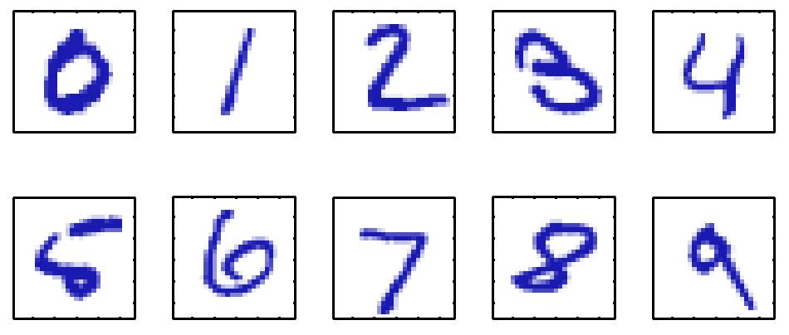
Example – Machine Learning
Handwritten Digit Recognition
T: Recognizing hand-written digits
E: Database of human-labeled images of handwritten digits
P: Percentage of digits correctly classified

Slide 6
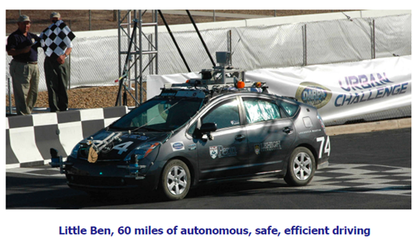
Example – Machine Learning
Self-driving Vehicles
T: Driving on four-lane highways using vision sensors
P: Average distance traveled before a human-judged error
E: A sequence of images and steering commands recorded while
observing a human driver.

Slide 7
Example – Machine Learning
Learning to recognize spoken words
(Lee, 1989; Waibel, 1989).
Learning to classify new astronomical structures (Fayyad et al., 1995).
Learning to play world-class backgammon
(Tesauro 1992, 1995).
Categorize email messages as spam or legitimate.

Slide 8

Machine Learning, a Magic?
No, more like gardening
Seeds = Algorithms
Nutrients = Data
Gardener = You
Plants = Programs

Slide 9
They said it!!
“A breakthrough in machine learning would be worth ten Microsofts”
- Bill Gates, Chairman, Microsoft
Machine learning is the hot new thing” - John Hennessy, President, Stanford
“Web rankings today are mostly a matter of machine learning”
- Prabhakar Raghavan, Dir. Research, Yahoo
“Machine learning is going to result in a real revolution” - Greg Papadopoulos, CTO, Sun
“Machine learning is today’s discontinuity” - Jerry Yang, CEO, Yahoo
“Machine learning is the next Internet” - Tony Tether, Director, DARPA

Slide 10
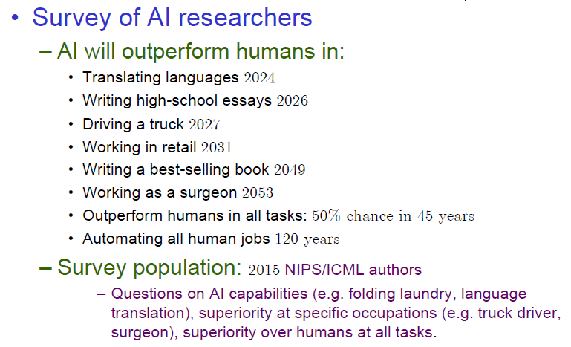
Future Prospects..

Slide 11
12 IT skills that employers can't say no to
COMPUTER WORLD
1) Machine learning
2) Mobilizing applications
3) Wireless networking
4) Human-computer interface
5) Project management
6) General networking skills
7) Network convergence technicians
8) Open-source programming
9) Business intelligence systems
10) Embedded security
11) Digital home technology integration
12) .Net, C #, C ++, Java -- with an edge

Slide 12
Thank You!

